Slide 1

Software-Hardware mapping in a Robot Design
Pavol Jusko, David Obdrzalek, Tomas Petrusek
Charles University, Prague
Notes:
Good afternoon. My name is Tom Petrusek and I’m from Faculty of Mathematics and physics of the Charles university in Prague.

Slide 2

Introduction
MART Robotic Team
How we improved the design and the implementation of our robot
  Built from scratch, then improved
  PC based
Software - Hardware mapping
Notes:
I will introduce our paper which describes the way how we have changed the design and implementation of our robot to be more robust, scalable and simpler to maintain, upgrade and further develop. All these improvements are improvements to the used software-hardware mapping between devices and the objects in the object-oriented software design.
I’m member of our faculty’s robotic team MART. We built our robot from scratch last year and this year we improved it a lot. It is a computer based robot because we use also camera computer vision.

Slide 3
Agenda
Original design
  Hardware
  Software
  Pros and Cons
New design
  Hardware changes
  Hardware modules
  Software changes
Conclusion
Notes:
First part will be about our original design from last year, its implementation, qualities and drawbacks. Later I will discuss the changes we made to the hardware and the software to improve the software and hardware mapping.

Slide 4
First idea
One MCU controlling all peripherals
RS-232 – Serial Port
Packet oriented protocol
Notes:
The first idea how to build a computer powered robot is grab a microcontroller, attach some devices (motors and encoders) and connect it with the computer. The easiest way how to communicate is trough serial link. We created also a simple packet oriented protocol to handle different devices on the controller.

Slide 5
Software design
What we wanted
  universal software
  for universal robot
  with any kind of hardware
Layered design
  Communication layer
  Hardware abstraction layer
  Smart layer
Notes:
We wanted to develop universal software for a universal robot which uses any kind of hardware. To achieve this (at least partly), we decided to implement a layered design of three layers.
The communication layer handles the mentioned serial link and takes care of the packet representation.
The hardware abstraction layer hides the real hardware implementation to the upper layer and it has two key tasks. The driving and localization.
The smart layer is the layer, where objectives of the robots mission are stored.

Slide 6
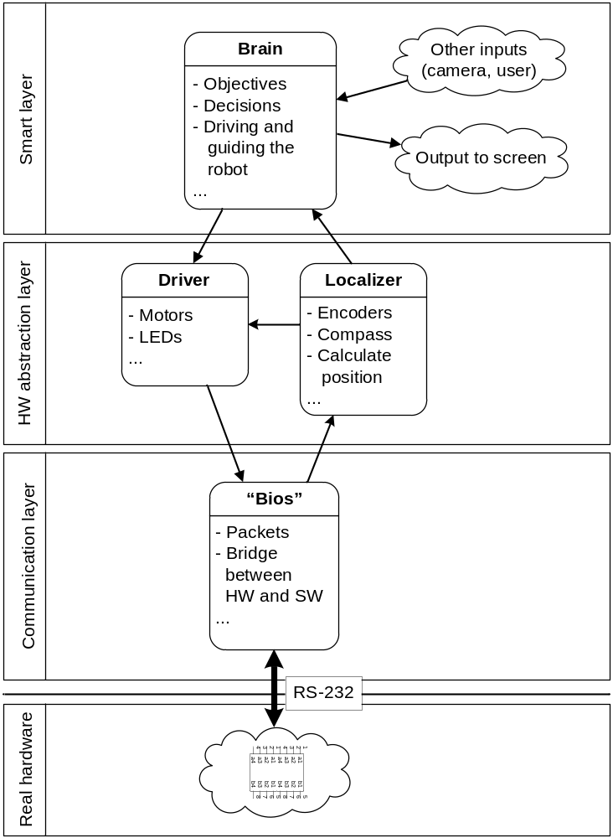
Notes:
This is the software diagram of the layers I talked about.
In the communication layer is a object called BIOS which handles the packet construction and creates a bridge between the real hardware and the software
The two tasks of the hardware abstraction layer are represented by the two objects called Driver and Localizer. Driver controls the motors. Localizer reads information from all the devices which can help robot positioning. It computes the exact position and let other objects to read and use it.
The smart layer is The brain of our robot. It is implemented as a finite state machine. To achieve the given objectives it also uses other devices, for example usb-connected webcamera.
The mapping here is quite simple, sensing devices as the Localizer and actuators as the Driver in the middle layer.

Slide 7
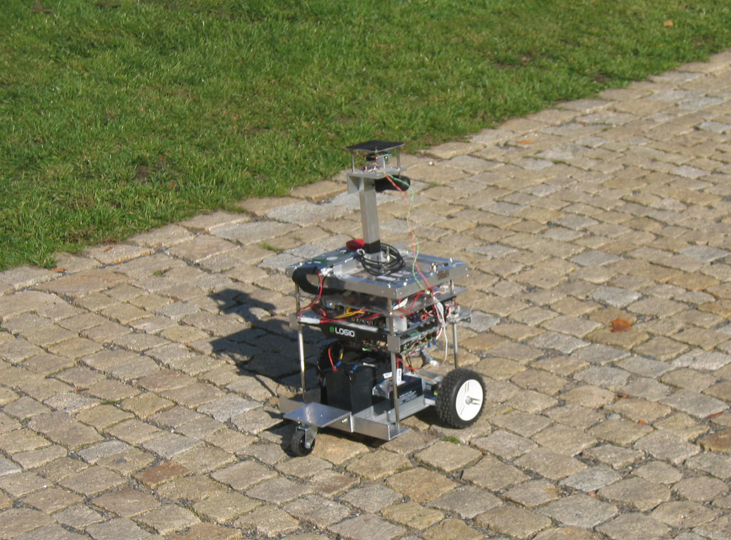
Pros and Cons
Pros
  Easy to create
  Worked well on two contests
    Eurobot 2007
    Robotour 2007
Notes:
The pros of this concept are that is was easy and straight forward to create.
It worked well on two contests. The last years Eurobot and Robotour also in 2007. The difference between these two contests is that eurobot is an indoor contest on a relatively small table for 90 seconds and robotour is an outdoor contest in a huge park in Prague where robots have to drive autonomously 1km long path in about a half an hour.

Slide 8
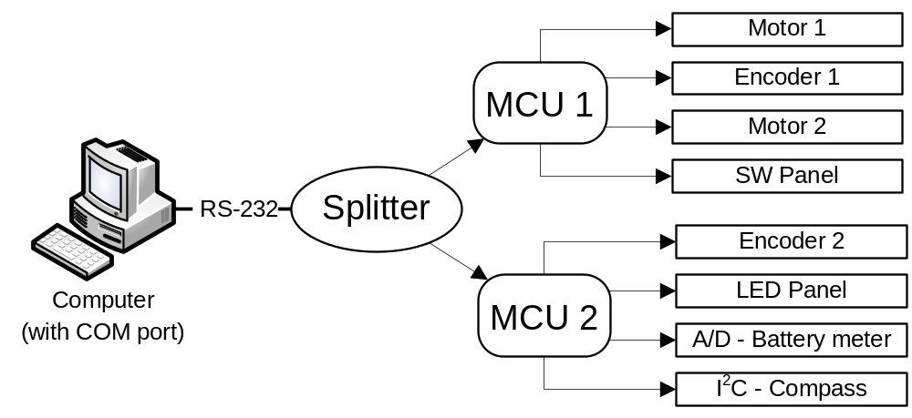
Pros and Cons
Cons
  “Hardcoded” solution
  Packet handling is not maintainable
  Hard to extend
  MCU limitations
Notes:
There are also drawbacks of this design. Mainly that it is a hardcoded solution. The packet handling is not maintainable and it is hard to extend. Later we wanted add some new devices and the limitations of the controller we used forced us to add a new controller and split the RS232 link. After this we had to use also packet addressing.
--- As the new edition of Eurobot was announced, we decided to use it as an opportunity to improve the HW and the also the SW design as well. The main reason for this was, that we wanted to develop and add new devices to improve the cognition and mobility of our robot.

Slide 9
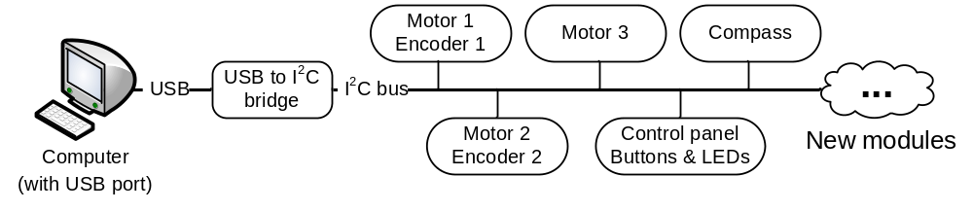
Hardware changes
Removed one-to-one concept
Bus topology
  I²C high speed bus with SMBus
USB to I2C bridge
Independent modules on the bus
Notes:
We removed the one-to-one concept and implemented new communication based on bus topology. We choosed I2C high speed bus with SMBus-based packet protocol as the new transport link. The layered design of the software allowed us to change quite a lot of hardware related parts with only small changes to the software. The i2c bus was connected to the computer with a usb to i2c bridge. The modules on the bus are independent.

Slide 10
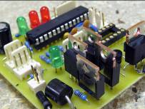
HBmotor board
MCU (Atmel AVR)
H-Bridge
Encoders
Switches
Notes:
This is an example of how our modules looked like. This is a motor board. On the board we have a controller, a H-Bridge and connectors for encoders and switches. These switches are usually connected to bumpers to detect whether the robot collides. The decision to have bumpers on this board allowed us to implement reflexes to our robot. Reflexes are implemented in the controller and they shorten the reaction time to some events so the reaction to collisions are much faster, almost immediate.
What is more important is that this board is only one application of our prototype firmware and kernel module. In general you can use any other sensor with this concept with just minor changes to the prototypes.

Slide 11
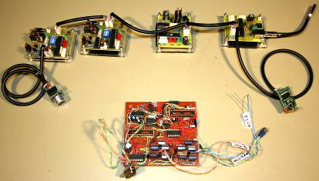
Hardware comparison
Notes:
This image shows, that changing the bus and make the hardware modular really helped the design and also the look.
On the picture we have the old hardware board with two slots for controllers. On top we have range finder, motor boards, compass and the usb to i2c bridge.

Slide 12
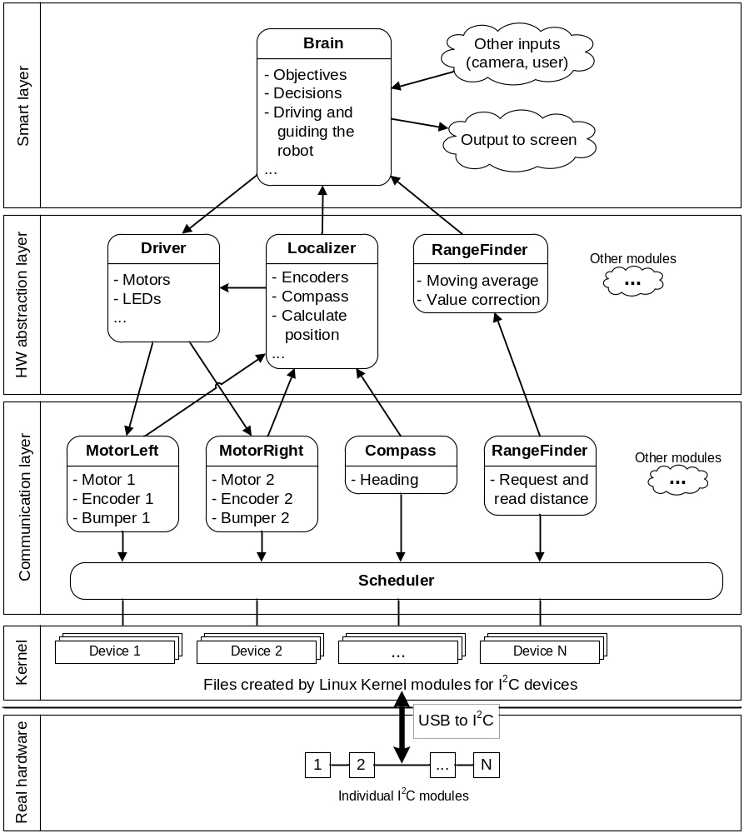
Notes:
This is the diagram of the new software design. This line (between Real HW and Kernel) represents the border between our hardware and the computer. The small boxes with numbers represent hardware modules connected with i2c bus connected to the computer with usb to i2c bridge. In the computer our kernel modules takes care of the new devices. They create directory for each device and file for each ability of the device. The upper layers use devices as files.
The three layers on top of the picture are layers of our application. In the communication layer we have object for each device. These objects maintains only the communication and data representation.
In the hardware abstraction layer the real hardware can be completely hidden (like motors in the Driver or encoders in the Localizer) or some value can be added to the device (like moving average for the range finder), so it can be used as smarter device.
In the Smart layer almost no changes were necessary.
The diagram may now look bigger, but the design consists of bigger number of smaller independent modules whose size does not reflect code size. In fact, the total size remained roughly the same.

Slide 13
Conclusion
More universal design
Better maintainability
Better extendibility
Easier changes
More possibilities for the future
Notes:
With the new design, the maintainability and upgradability of our robot improved a lot. Lot of hardcoded stuff has been removed and replaced with better solutions. This new design allows improving the robot by adding new devices with only minimal effort. From the future plans I can mention adding new devices like GPS receiver, acceleration meter, range finders or new motors. Even the change of the transport link from i2c to for example CAN is easily possible.
With improved software hardware mapping we achieved our goal, to make a more universal software for a more universal robot with a wide variety of devices. In top of this it is easier to understand, maintain and extend.

Slide 14
Thank you for your time
Questions?
Pavol Jusko, David Obdrzalek, Tomas Petrusek
Charles University, Prague
http://mart.matfyz.cz, petrusek@gmail.com
Notes:
If you are interested in our robot, the design or the algorithms we used, you can check out our teams poster somewhere around, come to our next presentation Saturday morning called Logion – Robot which collects rocks or visit our web pages.
Thank you very much for your attention.

